Slide 1
Machine Learning ZG565
Dr. Sugata Ghosal
Sugata.ghosal@pilani.bits-pilani.ac.in

Slide 2
Session 2
Date – 27th May 2023
Time – 2 PM to 4 PM
These slides are prepared by the instructor, with grateful acknowledgement of many others who made their course materials freely available online.

Slide 3
Session Content
Data - Types, Attributes
Data Quality
Data Preprocessing
Performance Metrics
Challenges of ML
Model Evaluation, Selection
Homework
Review Lab Capsule 1 from the “Machine Learning” Virtual Labs (accessible via elearn portal)

Slide 4
ML in a Nutshell
Tens of thousands of machine learning algorithms
Hundreds new every year
Every ML algorithm has three components
Data Representation
Parameter Optimization
Model Evaluation, Selection
Slide credit: Pedro Domingos

Slide 5


ML in Practice
Understand domain, prior knowledge, and goals
Data integration, selection, cleaning, pre-processing, etc.
Learn optimal parameter of the models
Interpret results
Consolidate and deploy discovered knowledge
Loop
Based on a slide by Pedro Domingos

Slide 6
Definition of Data
Collection of data objects and their attributes
An attribute is a property or characteristic of an object
Examples: eye color of a person, temperature, etc.
aka variable, field, characteristic, dimension, or feature
A collection of attributes describe an object
Object is also known as record, point, case, sample, entity, or instance
Attributes
Objects

Slide 7
Attribute Values
Attribute values are numbers or symbols assigned to an attribute for a particular object
Distinction between attributes and attribute values
Same attribute can be mapped to different attribute values
Example: height can be measured in feet or meters
Different attributes can be mapped to the same set of values
Example: Attribute values for ID and age are integers
But properties of attribute can be different than the properties of the values used to represent the attribute

Slide 8
Types of Attributes
There are different types of attributes
Nominal
Examples: ID numbers, zip codes
Ordinal
Examples: rankings (e.g., taste of potato chips on a scale from 1-10), grades, height {tall, medium, short}
Interval
Examples: calendar dates, temperatures in Celsius or Fahrenheit.
Ratio
Examples: temperature in Kelvin, length, counts, elapsed time (e.g., time to run a race)

Slide 9
Properties of Attribute Values
The type of an attribute depends on which of the following properties/operations it possesses:
Distinctness: = ≠
Order: < >
Differences are + - meaningful :
Ratios are * / meaningful
Nominal attribute: distinctness
Ordinal attribute: distinctness & order
Interval attribute: distinctness, order & meaningful differences
Ratio attribute: all 4 properties/operations

Slide 10
Difference Between Ratio and Interval
Is it physically meaningful to say that a temperature of 10 ° is twice that of 5° on
the Celsius scale?
the Fahrenheit scale?
the Kelvin scale?
Consider measuring the height above average
If Bill’s height is three inches above average and Bob’s height is six inches above average, then would we say that Bob is twice as tall as Bill?
Is this situation analogous to that of temperature?

Slide 11
This categorization of attributes is due to S. S. Stevens

Slide 12
This categorization of attributes is due to S. S. Stevens

Slide 13
Discrete and Continuous Attributes
Discrete Attribute
Has only a finite or countably infinite set of values
Examples: zip codes, counts, or the set of words in a collection of documents
Often represented as integer variables.
Note: binary attributes are a special case of discrete attributes
Continuous Attribute
Has real numbers as attribute values
Examples: temperature, height, or weight.
Practically, real values can only be measured and represented using a finite number of digits.
Continuous attributes are typically represented as floating-point variables.

Slide 14
Asymmetric Attributes
Only presence (a non-zero attribute value) is regarded as important
Words present in documents
Items present in customer transactions
If we met a friend in the grocery store would we ever say the following? “I see our purchases are very similar since we didn’t buy most of the same things.”

Slide 15
Key Messages for Attribute Types
The types of operations you choose should be “meaningful” for the type of data you have
Distinctness, order, meaningful intervals, and meaningful ratios are only four (among many possible) properties of data
The data type you see – often numbers or strings – may not capture all the properties or may suggest properties that are not present
Analysis may depend on these other properties of the data
Many statistical analyses depend only on the distribution
In the end, what is meaningful can be specific to domain

Slide 16
Important Characteristics of Data
Dimensionality (number of attributes)
High dimensional data brings a number of challenges
Sparsity
Only presence counts
Resolution
Patterns depend on the scale
Size
Type of analysis may depend on size of data

Slide 17
Types of data sets
Record
Data Matrix
Document Data
Transaction Data
Graph
World Wide Web
Molecular Structures
Ordered
Spatial Data
Temporal Data
Sequential Data
Genetic Sequence Data

Slide 18
Record Data
Data that consists of a collection of records, each of which consists of a fixed set of attributes

Slide 19
Data Matrix
If data objects have the same fixed set of numeric attributes, then the data objects can be thought of as points in a multi-dimensional space, where each dimension represents a distinct attribute
Such a data set can be represented by an m by n matrix, where there are m rows, one for each object, and n columns, one for each attribute

Slide 20
Document Data
Each document becomes a ‘term’ vector
Each term is a component (attribute) of the vector
The value of each component is the number of times the corresponding term occurs in the document.

Slide 21
Transaction Data
A special type of data, where
Each transaction involves a set of items.
For example, consider a grocery store. The set of products purchased by a customer during one shopping trip constitute a transaction, while the individual products that were purchased are the items.
Can represent transaction data as record data

Slide 22
Graph Data
Examples: Generic graph, a molecule, and webpages
Benzene Molecule: C6H6

Slide 23
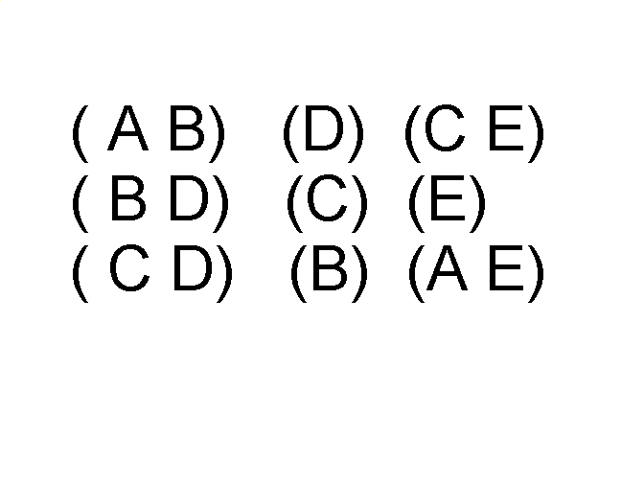
Ordered Data
Sequences of transactions
Items/Events
An element of the sequence

Slide 24
Ordered Data
Genomic sequence data

Slide 25
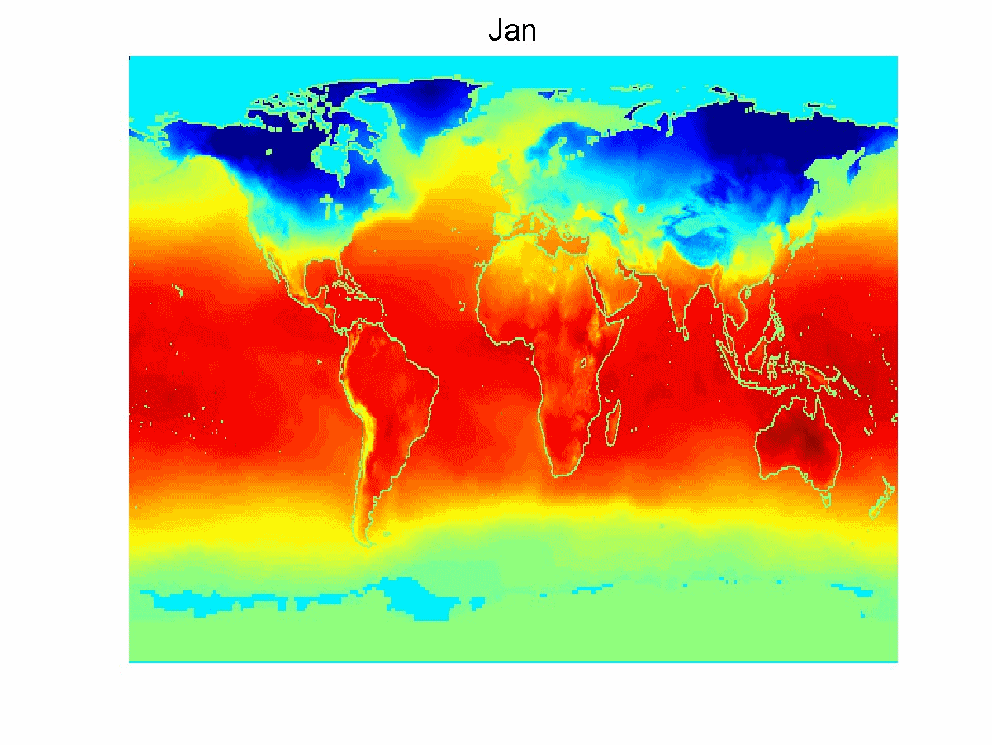
Ordered Data
Spatiotemporal Data
Average Monthly Temperature of land and ocean

Slide 26
Data Quality
Poor data quality negatively affects many data processing efforts
ML example: a classification model for detecting people who are loan risks is built using poor data
Some credit-worthy candidates are denied loans
More loans are given to individuals that default

Slide 27
Data Quality …
What kinds of data quality problems?
How can we detect problems with the data?
What can we do about these problems?
Examples of data quality problems:
Noise and outliers
Wrong data
Fake data
Missing values
Duplicate data

Slide 28
Noise
For objects, noise is an extraneous object
For attributes, noise refers to modification of original values
Examples: distortion of a person’s voice when talking on a poor phone and “snow” on television screen
The figures below show two sine waves of the same magnitude and different frequencies, the waves combined, and the two sine waves with random noise
The magnitude and shape of the original signal is distorted

Slide 29

Outliers
Outliers are data objects with characteristics that are considerably different than most of the other data objects in the data set
Case 1: Outliers are noise that interferes with data analysis
Case 2: Outliers are the goal of our analysis
Credit card fraud
Intrusion detection
Causes?

Slide 30
Missing Values
Reasons for missing values
Information is not collected (e.g., people decline to give their age and weight)
Attributes may not be applicable to all cases (e.g., annual income is not applicable to children)
Handling missing values
Eliminate data objects or variables
Estimate missing values
Example: time series of temperature
Example: census results
Ignore the missing value during analysis

Slide 31
Duplicate Data
Data set may include data objects that are duplicates, or almost duplicates of one another
Major issue when merging data from heterogeneous sources
Examples:
Same person with multiple email addresses
Data cleaning
Process of dealing with duplicate data issues

Slide 32
Data Preprocessing
Aggregation
Sampling
Discretization and Binarization
Attribute Transformation
Dimensionality Reduction
Feature subset selection
Feature creation

Slide 33
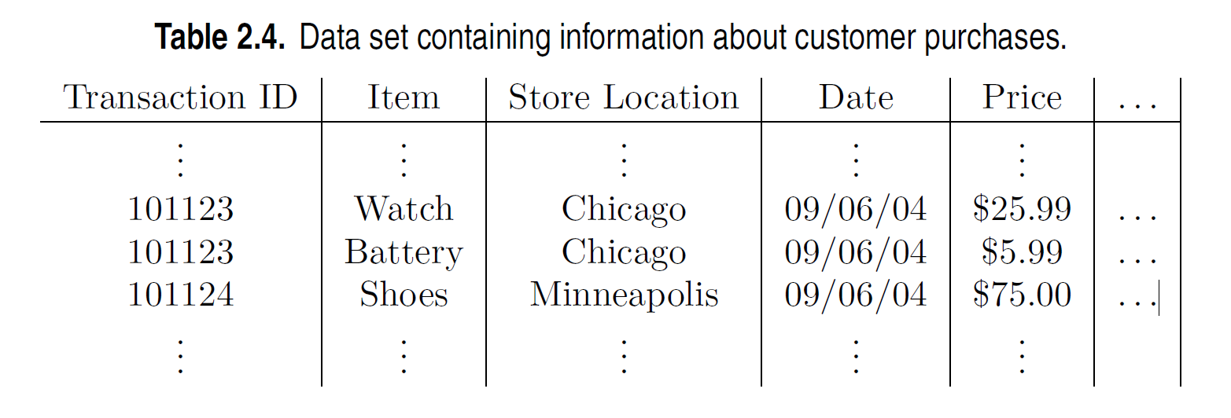
Aggregation
Combining two or more attributes (or objects) into a single attribute (or object)
Purpose
Data reduction - reduce the number of attributes or objects
Change of scale
Cities aggregated into regions, states, countries, etc.
Days aggregated into weeks, months, or years
More “stable” data - aggregated data tends to have less variability

Slide 34
Example: Precipitation in Australia
This example is based on precipitation in Australia from the period 1982 to 1993.
The next slide shows
A histogram for the standard deviation of average monthly precipitation for 3,030 0.5◦ by 0.5◦ grid cells in Australia, and
A histogram for the standard deviation of the average yearly precipitation for the same locations.
The average yearly precipitation has less variability than the average monthly precipitation.
All precipitation measurements (and their standard deviations) are in centimeters.

Slide 35
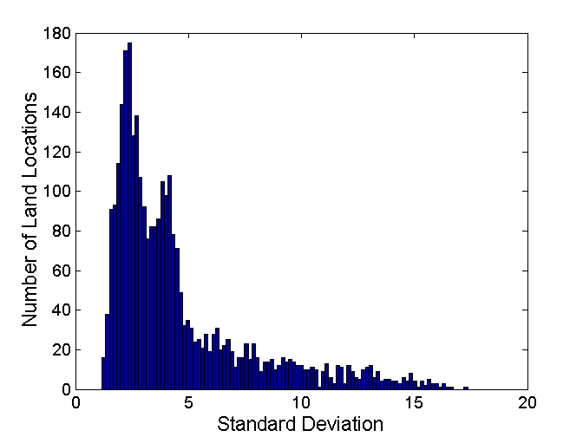
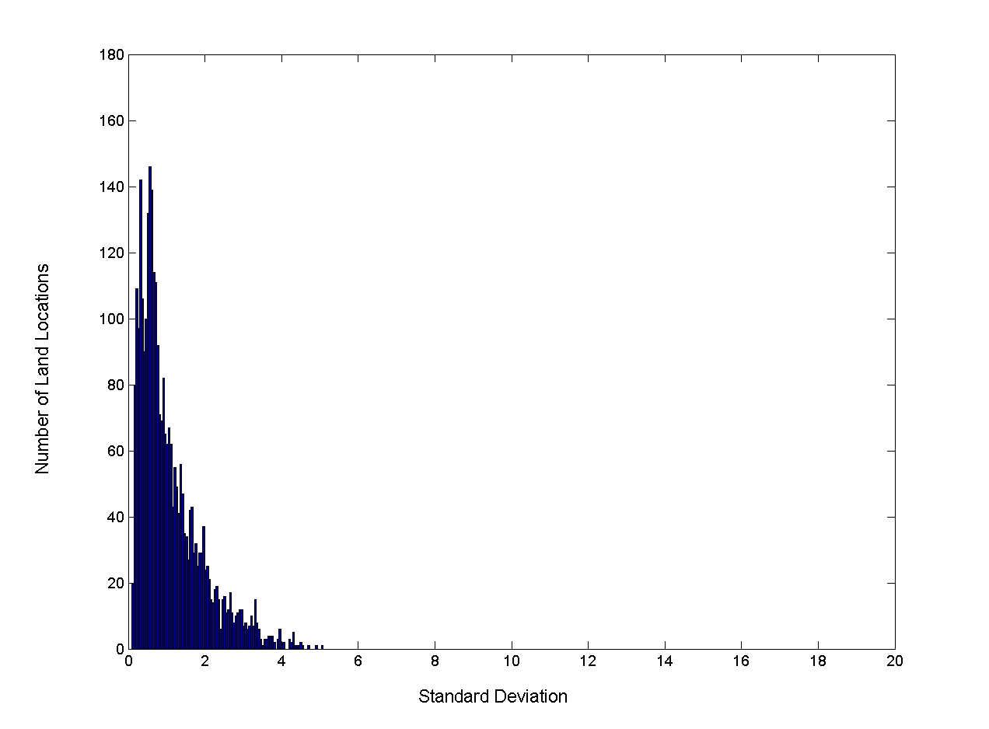
Example: Precipitation in Australia (contd)
Variation of Precipitation in Australia
Standard Deviation of Average Monthly Precipitation
Standard Deviation of Average Yearly Precipitation

Slide 36
Sampling
Sampling is the main technique employed for data reduction.
It is often used for both the preliminary investigation of the data and the final data analysis.
Statisticians often sample because obtaining the entire set of data of interest is too expensive or time consuming.
Sampling is typically used in data mining because processing the entire set of data of interest is too expensive or time consuming.

Slide 37
Sampling …
The key principle for effective sampling is the following:
Using a sample will work almost as well as using the entire data set, if the sample is representative
A sample is representative if it has approximately the same properties (of interest) as the original set of data

Slide 38

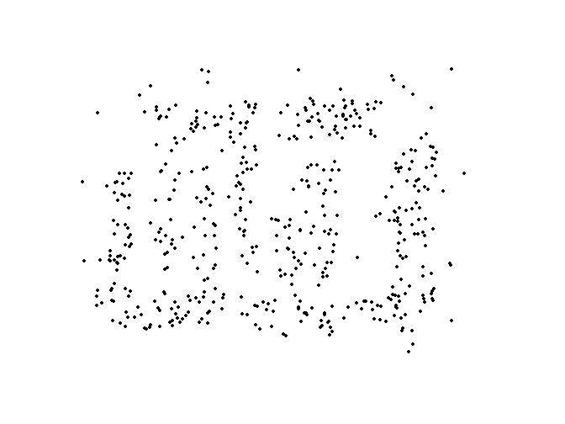
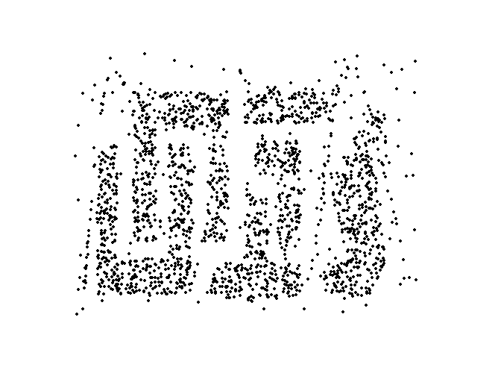
Sample Size
8000 points 2000 Points 500 Points

Slide 39
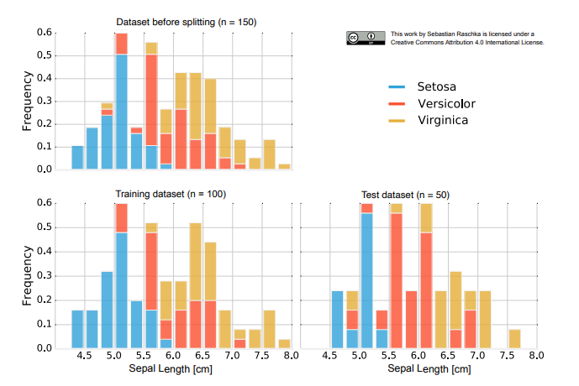
Issues with Subsampling (Independence Violation)
IRIS Dataset of Flowers
50 Setosa, 50 Versicolor, and 50 Virginica
Random subsampling can assign 2/3 (100) to training set and 1/3 (50) to the test set
Training set → 38 x Setosa, 28 x Versicolor, 34 x Virginica
Test set → 12 x Setosa, 22 x Versicolor, 16 x Virginica

Slide 40
Types of Sampling
Simple Random Sampling
There is an equal probability of selecting any particular item
Sampling without replacement
As each item is selected, it is removed from the population
Sampling with replacement
Objects are not removed from the population as they are selected for the sample.
In sampling with replacement, the same object can be picked up more than once
Stratified sampling
Split the data into several partitions; then draw random samples from each partition

Slide 41
Building Classifiers with Imbalanced Training Set
Modify the distribution of training data so that rare class is well-represented in training set
Undersample the majority class
Oversample the rare class

Slide 42
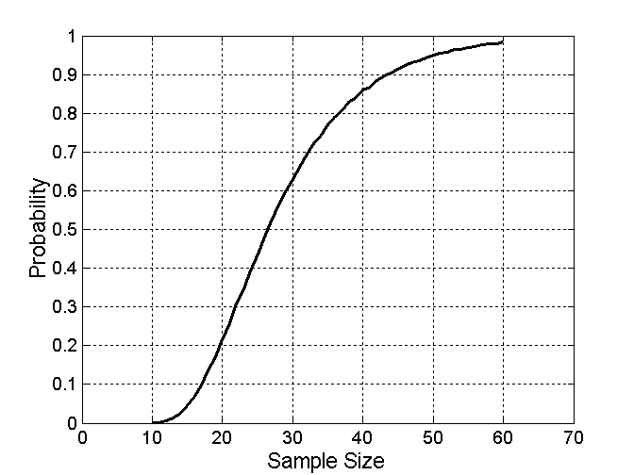
Sample Size
What sample size is necessary to get at least one object from each of 10 equal-sized groups.

Slide 43
Discretization
Discretization is the process of converting a continuous attribute into an ordinal attribute
A potentially infinite number of values are mapped into a small number of categories
Discretization is used in both unsupervised and supervised settings

Slide 44
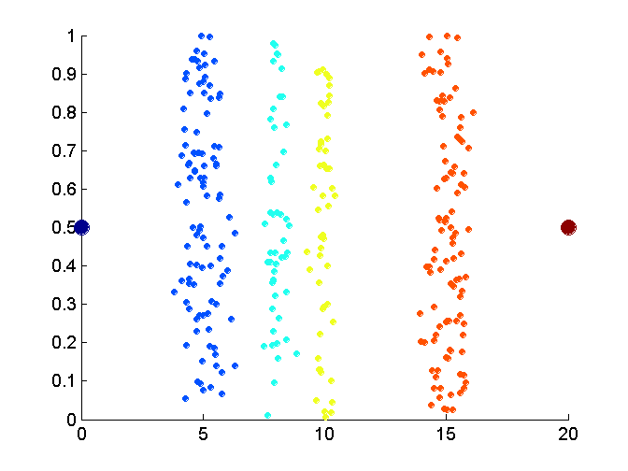
Unsupervised Discretization
Data consists of four groups of points and two outliers. Data is one-dimensional, but a random y component is added to reduce overlap.

Slide 45
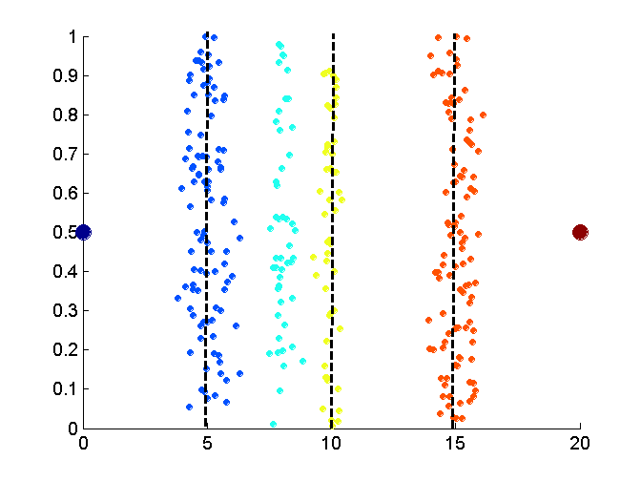
Unsupervised Discretization
Equal interval width approach used to obtain 4 values.

Slide 46
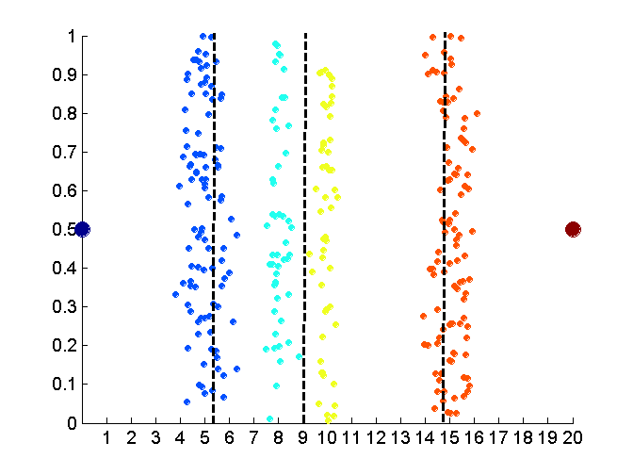
Unsupervised Discretization
Equal frequency approach used to obtain 4 values.

Slide 47
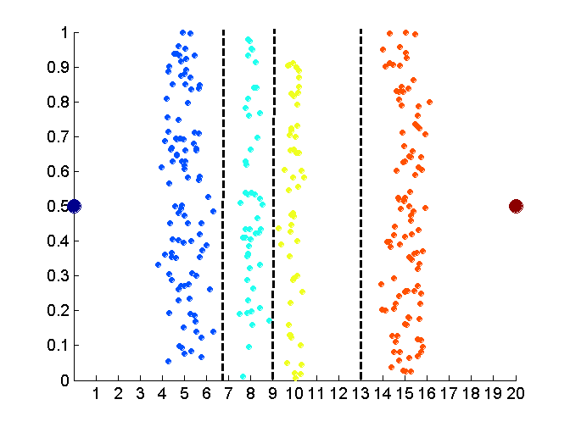
Unsupervised Discretization
K-means approach to obtain 4 values.

Slide 48
Discretization in Supervised Settings
Many classification algorithms work best if both the independent and dependent variables have only a few values
We give an illustration of the usefulness of discretization using the following example.

Slide 49
Binarization
Binarization maps a continuous or categorical attribute into one or more binary variables

Slide 50
Attribute Transformation
An attribute transform is a function that maps the entire set of values of a given attribute to a new set of replacement values such that each old value can be identified with one of the new values
Simple functions: x^{k}, log(x), e^{x}, |x|
Normalization
Refers to various techniques to adjust to differences among attributes in terms of frequency of occurrence, mean, variance, range
Take out unwanted, common signal, e.g., seasonality
In statistics, standardization refers to subtracting off the means and dividing by the standard deviation

Slide 51
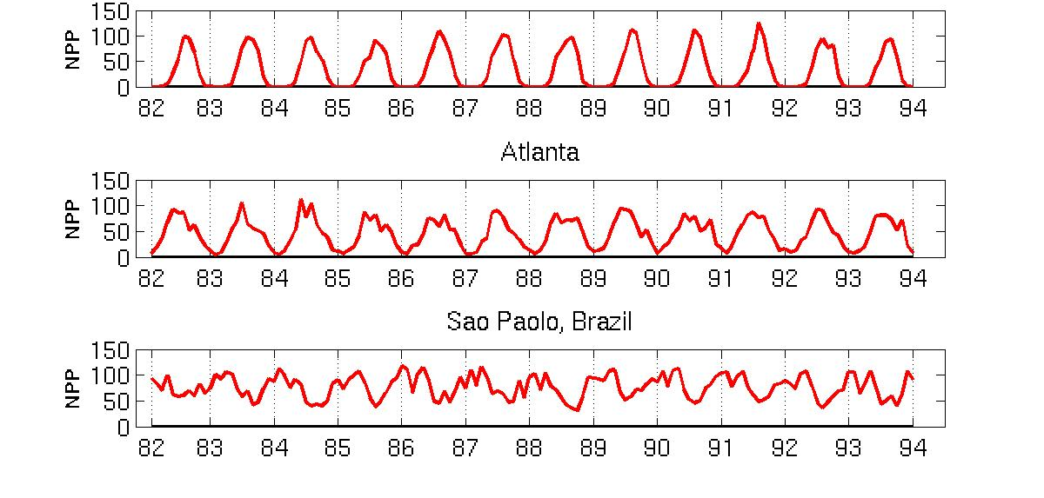
Example: Sample Time Series of Plant Growth
Minneapolis
Net Primary Production (NPP) is a measure of plant growth used by ecosystem scientists.
Correlations between time series
Correlations between time series

Slide 52
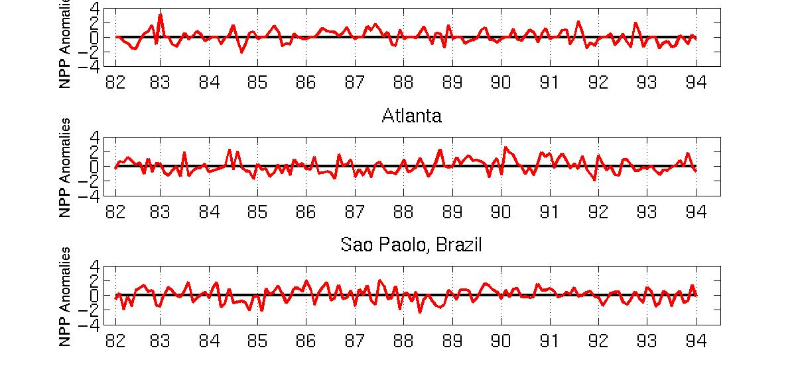
Seasonality Accounts for Much Correlation
Minneapolis
Normalized using monthly Z Score:
Subtract off monthly mean and divide by monthly standard deviation
Correlations between time series
Correlations between time series

Slide 53
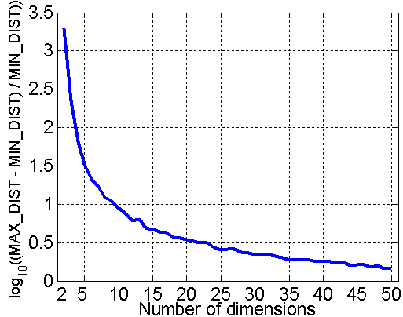
Curse of Dimensionality
When dimensionality increases, data becomes increasingly sparse in the space that it occupies
Definitions of density and distance between points, which are critical for clustering and outlier detection, become less meaningful
Randomly generate 500 points
Compute difference between max and min distance between any pair of points

Slide 54
Dimensionality Reduction
Purpose:
Avoid curse of dimensionality
Reduce amount of time and memory required by data mining algorithms
Allow data to be more easily visualized
May help to eliminate irrelevant features or reduce noise
Techniques
Principal Components Analysis (PCA)
Singular Value Decomposition
Others: supervised and non-linear techniques

Slide 55
Feature Subset Selection
Another way to reduce dimensionality of data
Redundant features
Duplicate much or all of the information contained in one or more other attributes
Example: purchase price of a product and the amount of sales tax paid
Irrelevant features
Contain no information that is useful for the data mining task at hand
Example: students' ID is often irrelevant to the task of predicting students' GPA
Many techniques developed, especially for classification

Slide 56
Feature Creation
Create new attributes that can capture the important information in a data set much more efficiently than the original attributes
Three general methodologies:
Feature extraction
Example: extracting edges from images
Feature construction
Example: dividing mass by volume to get density
Mapping data to new space
Example: Fourier and wavelet analysis

Slide 57
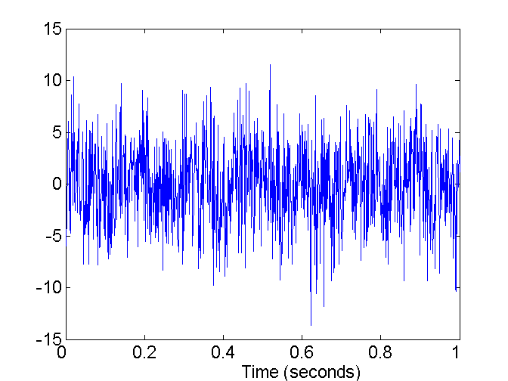
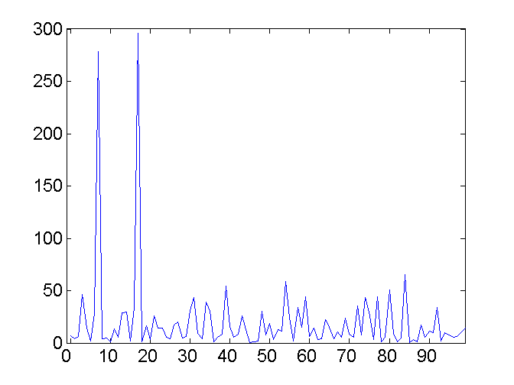
Mapping Data to a New Space
Fourier and wavelet transform
Frequency
Two Sine Waves + Noise
Frequency

Slide 58
Evaluation Metrics: Confusion Matrix
 | PREDICTED CLASS
ACTUAL CLASS |  | Class=Yes | Class=No
 | Class=Yes | a | b
 | Class=No | c | d
a: TP (true positive)
b: FN (false negative)
c: FP (false positive)
d: TN (true negative)

Slide 59
Evaluation Metrics: Accuracy
 | PREDICTED CLASS
ACTUAL CLASS |  | Class=Yes | Class=No
 | Class=Yes | a (TP) | b (FN)
 | Class=No | c (FP) | d (TN)
Most widely-used metric:

Slide 60
Class Imbalance Problem
Lots of classification problems where the classes are skewed (more records from one class than another)
Credit card fraud
Intrusion detection
Defective products in manufacturing assembly line
COVID-19 test results on a random sample
Key Challenge:
Evaluation measures such as accuracy are not well-suited for imbalanced class

Slide 61
Problem with Accuracy
Consider a 2-class problem
Number of Class NO examples = 990
Number of Class YES examples = 10
If a model predicts everything to be class NO, accuracy is 990/1000 = 99 %
This is misleading because this trivial model does not detect any class YES example
Detecting the rare class is usually more interesting (e.g., frauds, intrusions, defects, etc)
 | PREDICTED CLASS
ACTUAL CLASS |  | Class=Yes | Class=No
 | Class=Yes | 0 | 10
 | Class=No | 0 | 990

Slide 62
Which model is better?
 | PREDICTED
ACTUAL |  | Class=Yes | Class=No
 | Class=Yes | 0 | 10
 | Class=No | 0 | 990
A
Accuracy: 99%
 | PREDICTED
ACTUAL |  | Class=Yes | Class=No
 | Class=Yes | 10 | 0
 | Class=No | 500 | 490
B
Accuracy: 50%

Slide 63
Which model is better?
 | PREDICTED
ACTUAL |  | Class=Yes | Class=No
 | Class=Yes | 5 | 5
 | Class=No | 0 | 990
A
B
 | PREDICTED
ACTUAL |  | Class=Yes | Class=No
 | Class=Yes | 10 | 0
 | Class=No | 500 | 490

Slide 64
Alternative Measures
 | PREDICTED CLASS
ACTUAL CLASS |  | Class=Yes | Class=No
 | Class=Yes | a | b
 | Class=No | c | d

Slide 65
Alternative Measures
 | PREDICTED CLASS
ACTUAL CLASS |  | Class=Yes | Class=No
 | Class=Yes | 10 | 0
 | Class=No | 10 | 980

Slide 66
Alternative Measures
 | PREDICTED CLASS
ACTUAL CLASS |  | Class=Yes | Class=No
 | Class=Yes | 10 | 0
 | Class=No | 10 | 980
 | PREDICTED CLASS
ACTUAL CLASS |  | Class=Yes | Class=No
 | Class=Yes | 1 | 9
 | Class=No | 0 | 990

Slide 67
Which of these classifiers is better?
 | PREDICTED CLASS
ACTUAL CLASS |  | Class=Yes | Class=No
 | Class=Yes | 40 | 10
 | Class=No | 10 | 40
A
B
 | PREDICTED CLASS
ACTUAL CLASS |  | Class=Yes | Class=No
 | Class=Yes | 40 | 10
 | Class=No | 1000 | 4000

Slide 68
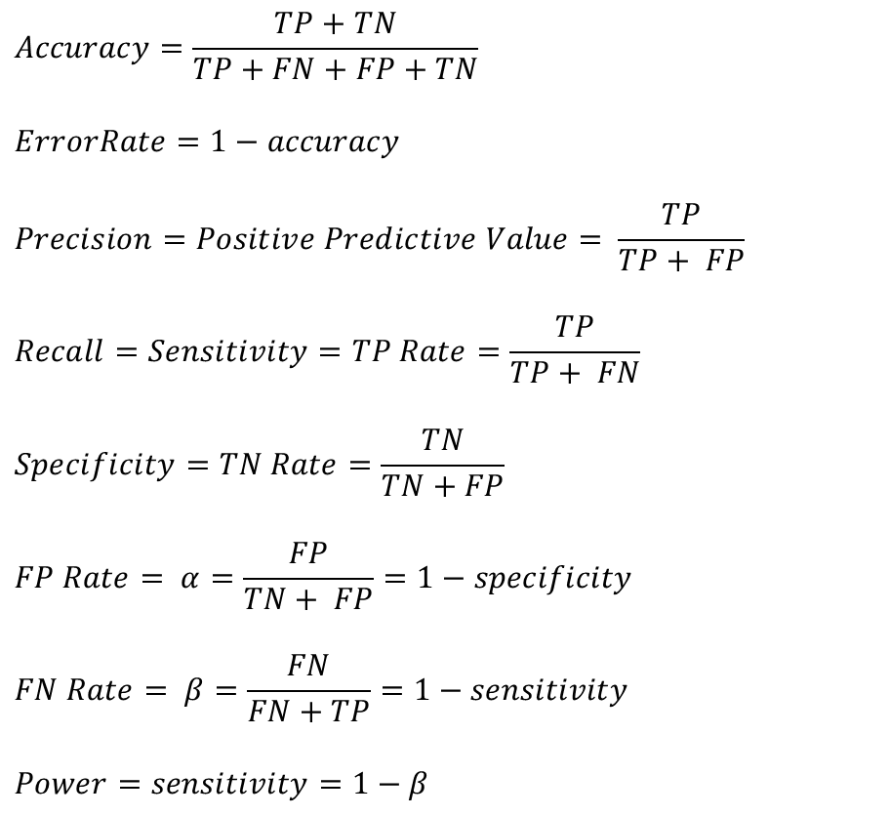
Measures of Classification Performance
 | PREDICTED CLASS
ACTUAL CLASS |  | Yes | No
 | Yes | TP | FN
 | No | FP | TN
α is the probability that we reject the null hypothesis when it is true. This is a Type I error or a false positive (FP).
β is the probability that we accept the null hypothesis when it is false. This is a Type II error or a false negative (FN).

Slide 69
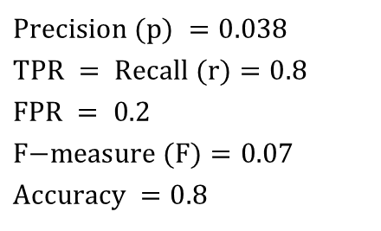
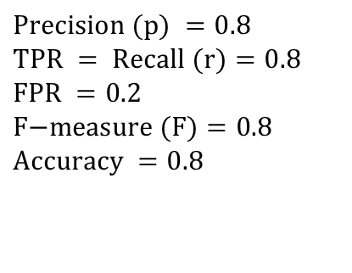
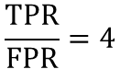
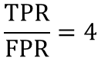
Alternative Measures
A | PREDICTED CLASS
ACTUAL CLASS |  | Class=Yes | Class=No
 | Class=Yes | 40 | 10
 | Class=No | 10 | 40
$$\text{Precision} (p) =0.8 \\ \text{TPR} = \text{Recall} (r)=0.8 \\ \text{FPR} =0.2 \\ \text{F}\text{−}\text{measure} (F)=0.8 \\ \text{Accuracy} =0.8$$
$$\frac{TPR}{FPR}=4$$
B | PREDICTED CLASS
ACTUAL CLASS |  | Class=Yes | Class=No
 | Class=Yes | 40 | 10
 | Class=No | 1000 | 4000
$$\text{Precision} (p) =0.038 \\ \text{TPR} = \text{Recall} (r)=0.8 \\ \text{FPR} =\text{ 0.2} \\ \text{F}\text{−}\text{measure} (F)=0.07 \\ \text{Accuracy} =0.8$$
$$\frac{TPR}{FPR}=4$$

Slide 70
Which of these classifiers is better?
A | PREDICTED CLASS
ACTUAL CLASS |  | Class=Yes | Class=No
 | Class=Yes | 10 | 40
 | Class=No | 10 | 40
B | PREDICTED CLASS
ACTUAL CLASS |  | Class=Yes | Class=No
 | Class=Yes | 25 | 25
 | Class=No | 25 | 25
C | PREDICTED CLASS
ACTUAL CLASS |  | Class=Yes | Class=No
 | Class=Yes | 40 | 10
 | Class=No | 40 | 10

Slide 71
ROC (Receiver Operating Characteristic)
A graphical approach for displaying trade-off between detection rate and false alarm rate
Developed in 1950s for signal detection theory to analyze noisy signals
ROC curve plots TPR against FPR
Performance of a model represented as a point in an ROC curve

Slide 72
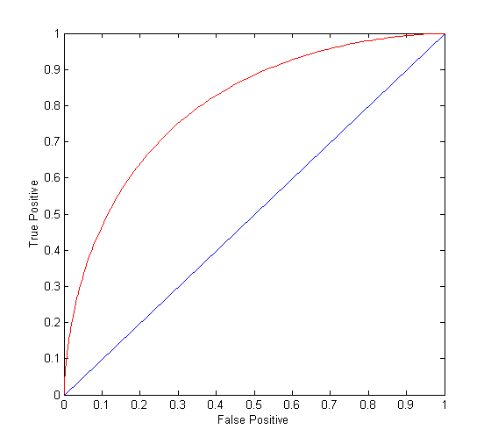
ROC Curve
(TPR,FPR):
(0,0): declare everything to be negative class
(1,1): declare everything to be positive class
(1,0): ideal
Diagonal line:
Random guessing
Below diagonal line:
prediction is opposite of the true class

Slide 73
ROC (Receiver Operating Characteristic)
To draw ROC curve, classifier must produce continuous-valued output
Outputs are used to rank test records, from the most likely positive class record to the least likely positive class record
By using different thresholds on this value, we can create different variations of the classifier with TPR/FPR tradeoffs
Many classifiers produce only discrete outputs (i.e., predicted class)
How to get continuous-valued outputs?
Decision trees, rule-based classifiers, neural networks, Bayesian classifiers, k-nearest neighbors, SVM

Slide 74
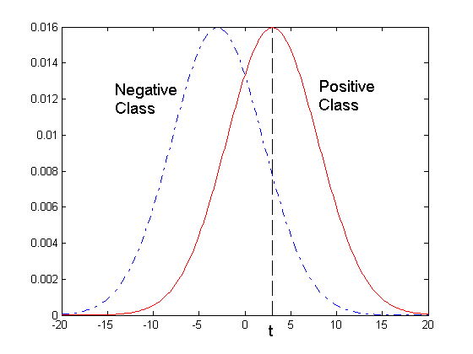
ROC Curve Example
1-dimensional data set containing 2 classes (positive and negative)
Any points located at x > t is classified as positive
At threshold t:
TPR=0.5, FNR=0.5, FPR=0.12, TNR=0.88

Slide 75
How to Construct an ROC curve
Use a classifier that produces a continuous-valued score for each instance
The more likely it is for the instance to be in the + class, the higher the score
Sort the instances in decreasing order according to the score
Apply a threshold at each unique value of the score
Count the number of TP, FP, TN, FN at each threshold
TPR = TP/(TP+FN)
FPR = FP/(FP + TN)
Instance | Score | True Class
1 | 0.95 | +
2 | 0.93 | +
3 | 0.87 | -
4 | 0.85 | -
5 | 0.85 | -
6 | 0.85 | +
7 | 0.76 | -
8 | 0.53 | +
9 | 0.43 | -
10 | 0.25 | +

Slide 76
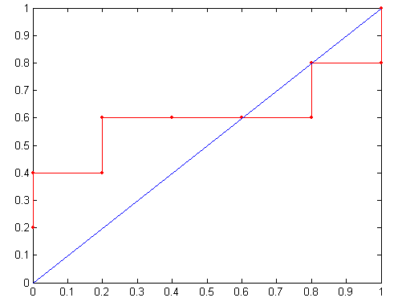
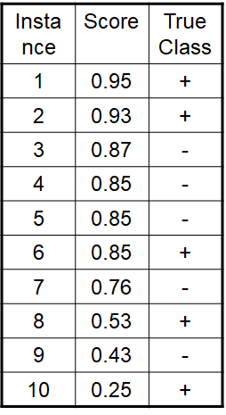
How to construct an ROC curve
Threshold >=
ROC Curve:

Slide 77
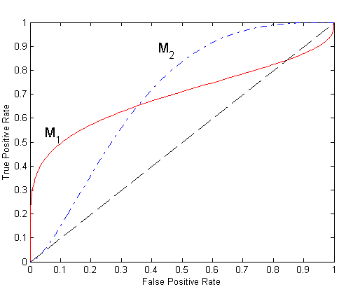
Using ROC for Model Comparison
No model consistently outperforms the other
M₁ is better for small FPR
M₂ is better for large FPR
Area Under the ROC curve (AUC)
Ideal:
Area = 1
Random guess:
Area = 0.5

Slide 78
Dealing with Imbalanced Classes - Summary
Many measures exists, but none of them may be ideal in all situations
Random classifiers can have high value for many of these measures
TPR/FPR provides important information but may not be sufficient by itself in many practical scenarios
Given two classifiers, sometimes you can tell that one of them is strictly better than the other
C1 is strictly better than C2 if C1 has strictly better TPR and FPR relative to C2 (or same TPR and better FPR, and vice versa)
Even if C1 is strictly better than C2, C1’s F-value can be worse than C2’s if they are evaluated on data sets with different imbalances
Classifier C1 can be better or worse than C2 depending on the scenario at hand (class imbalance, importance of TP vs FP, cost/time tradeoffs)

Slide 79
Which Classifier is better?
T1 | PREDICTED CLASS
ACTUAL CLASS |  | Class=Yes | Class=No
 | Class=Yes | 50 | 50
 | Class=No | 1 | 99
T2 | PREDICTED CLASS
ACTUAL CLASS |  | Class=Yes | Class=No
 | Class=Yes | 99 | 1
 | Class=No | 10 | 90
T3 | PREDICTED CLASS
ACTUAL CLASS |  | Class=Yes | Class=No
 | Class=Yes | 99 | 1
 | Class=No | 1 | 99

Slide 80
Which Classifer is better? Medium Skew case
T1 | PREDICTED CLASS
ACTUAL CLASS |  | Class=Yes | Class=No
 | Class=Yes | 50 | 50
 | Class=No | 10 | 990
T2 | PREDICTED CLASS
ACTUAL CLASS |  | Class=Yes | Class=No
 | Class=Yes | 99 | 1
 | Class=No | 100 | 900
T3 | PREDICTED CLASS
ACTUAL CLASS |  | Class=Yes | Class=No
 | Class=Yes | 99 | 1
 | Class=No | 10 | 990

Slide 81
Which Classifer is better? High Skew case
T1 | PREDICTED CLASS
ACTUAL CLASS |  | Class=Yes | Class=No
 | Class=Yes | 50 | 50
 | Class=No | 100 | 9900
T2 | PREDICTED CLASS
ACTUAL CLASS |  | Class=Yes | Class=No
 | Class=Yes | 99 | 1
 | Class=No | 1000 | 9000
T3 | PREDICTED CLASS
ACTUAL CLASS |  | Class=Yes | Class=No
 | Class=Yes | 99 | 1
 | Class=No | 100 | 9900

Slide 82
Challenges of Machine Learning
Training Data
Insufficient
Non representative
Model Selection
Overfitting
Underfitting
Validation and Testing

Slide 83
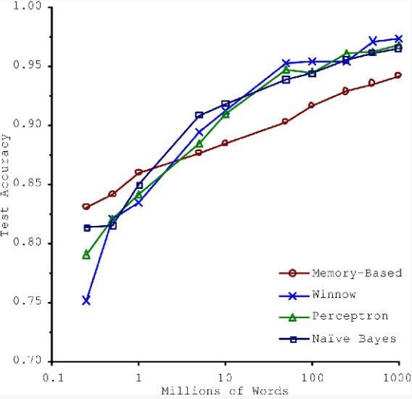
Insufficient Training Data
Consider trade-off Between Algorithm development & training data capture

Slide 84
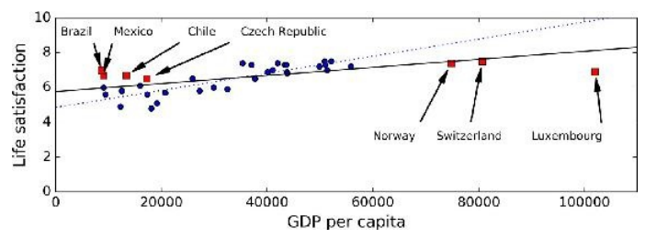
Non-representative Training Data
Training Data be representative of the new cases we want to generalize
Small sample size leads to sampling noise
Missing data over emphasizes the role of wealth on happiness
If sampling process is flawed, even large sample size can lead to sampling bias
missing data
available data

Slide 85
Data Quality
Cleaning often needed for improving data quality
Some instances have missing features
e.g., 5% of customers did not specify their age
Ignore the instances all together or the feature,
fill in the missing values
Some instances can be erroneous, noisy or outliers
Human or machine generated
Identify, discard or fix manually, as appropriate

Slide 86
Irrelevant Features
Feature engineering needed for coming up with a good set of features
Feature selection
more useful features to train on among existing features.
Feature extraction
combine existing features to produce a more useful one.
Create new features by gathering new data

Slide 87
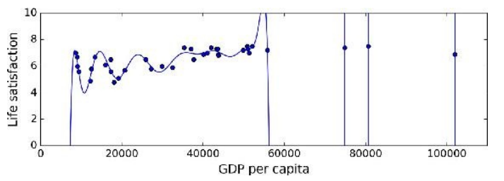
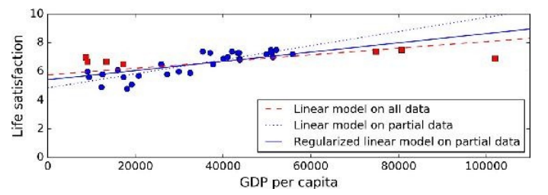
Model Selection
Overfitting or Underfitting
Overfitting leads to high performance in training set but performs poorly on new data
e.g., a high-degree polynomial life satisfaction model that strongly overfits the training data
Small training set or sampling noise can lead to model following the noise than the underlying pattern in the dataset
Solution: Regularization to constrain the values of parameters
Underfitting when the model is too simple to learn the underlying structure in the data
Select a more powerful model, with more parameters
Feed better features to the learning algorithm
Reduce regularization
Large slope
High-order
polynomial
Smaller slope

Slide 88
Choice of Hyperparameters
Modern ML models often use a lot of model parameters
Known as hyperparameters
Model performance depends on choice of parameters
Each parameter can assume a number of values
Real numbers or categories
Exponential number of hyperparameter combinations possible
Best model correspond to best cross validation performance over the set of hyperparameter combinations
Expensive to perform
Some empirical frameworks available for hyperparameter optimization
Grid search
Random search
Bayesian

Slide 89
Evaluating Predictive Performance of a Model
Want to estimate the generalization performance, the predictive performance of our model on future (unseen) data.
Want to increase the predictive performance by tweaking the learning algorithm and selecting the best performing model from a given hypothesis space.
Want to identify the ML algorithm that is best-suited for the problem at hand; thus, we want to compare different algorithms, selecting the best-performing one as well as the best performing model from the algorithm’s hypothesis space.

Slide 90
Evaluation and Validation
Performance of ML algorithms is statistical / predictive
Good ML algorithms need to work well on test data
But test data is often not accessible to the provider of the algorithm
Common assumption is training data is representative of test data
Randomly chosen subset of the training data is held out as validation set, aka dev set
Once ML model is trained, its performance is evaluated on validation data
Expectation is ML model working well on validation set will work well on unknown test data
Typically 20-30% of the data is randomly held out as validation data

Slide 91
Cross Validation
K-fold validation is often performed
To reduce the bias of validation set selection process
Often K is chosen as 10
aka 10 fold cross validation
10 fold cross validation involves
randomly selecting the validation set 10 times
model generation with 10 resulting training set
Evaluate the performance of each on that validation set
averaging the performance over the validation sets

Slide 92
Training vs Testing
What do we want?
High accuracy on training data?
No, high accuracy on unseen/new/test data!
Why is this tricky?
Training data
Features (x) and labels (y) used to learn mapping f
Test data
Features used to make a prediction
Labels only used to see how well we’ve learned f!!!
Validation data
Held-out set of the training data
Can use both features and labels to tune parameters of the model we’re learning
Slide Credit: Adriana Kovashka

Slide 93
Training vs. Test Distribution
We generally assume that training and test examples are independently drawn from the same overall distribution of data
– We call this “i.i.d” which stands for “independent and identically distributed”
Slide credit: Ray Mooney

Slide 94
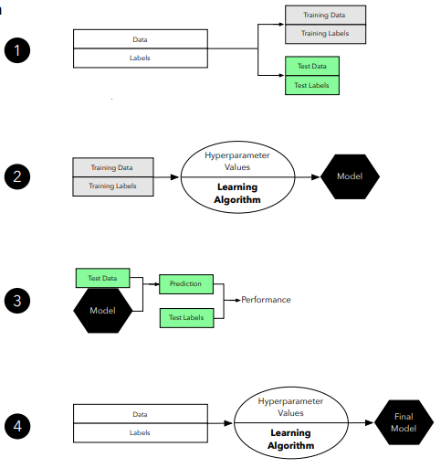
Holdout for Model Evaluation

Slide 95
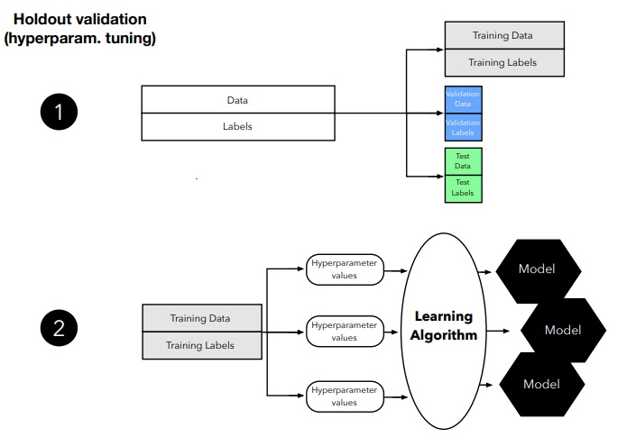
Holdout for Model Selection (1)

Slide 96
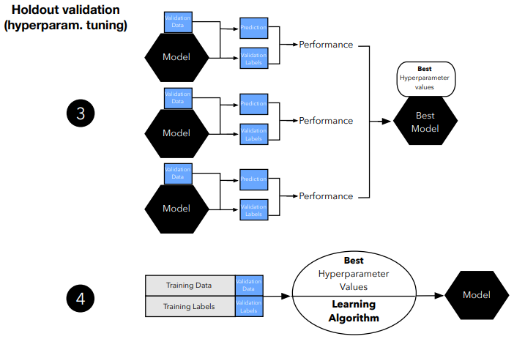
Holdout for Model Selection (2)

Slide 97
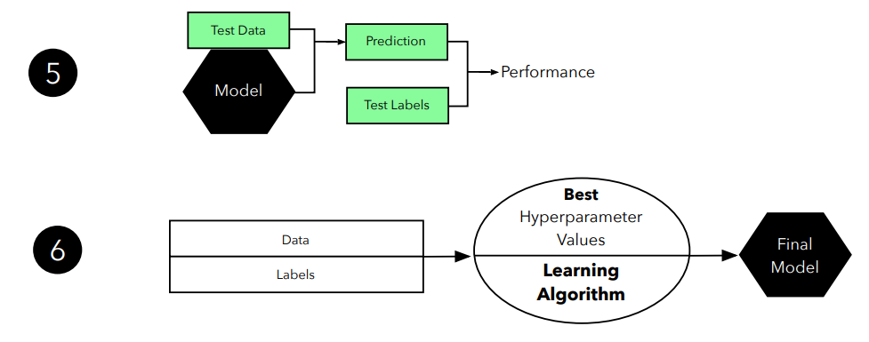
Holdout for Model Selection (3)

Slide 98
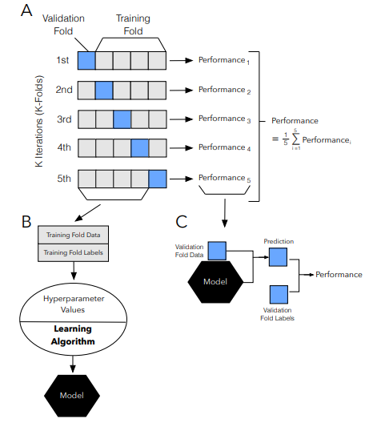
K Fold Cross Validation (CV) for Model Evaluation

Slide 99
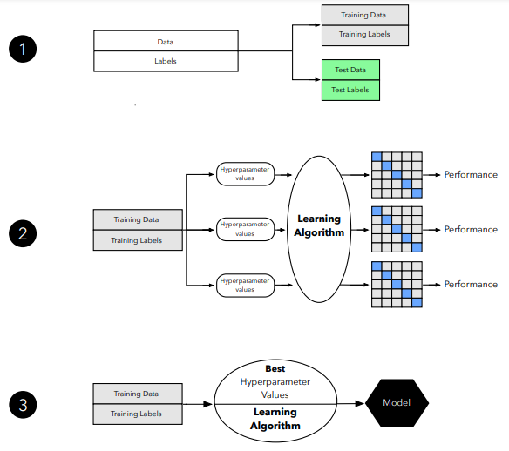
CV for Model Selection (1)

Slide 100
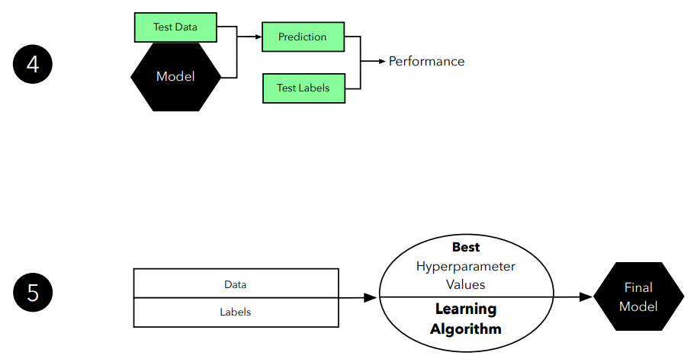
CV for Model Selection (2)

Slide 101
END of Session 2

